Slide 1
Programming Shared Address Space Platforms
Ananth Grama, Anshul Gupta, George Karypis, and Vipin Kumar
To accompany the text ``Introduction to Parallel Computing'', Addison Wesley, 2003.

Slide 2
OpenMP: a Standard for Directive Based Parallel Programming
OpenMP is a directive-based API that can be used with FORTRAN, C, and C++ for programming shared address space machines.
OpenMP directives provide support for concurrency, synchronization, and data handling while obviating the need for explicitly setting up mutexes, condition variables, data scope, and initialization.

Slide 3
OpenMP Programming Model
OpenMP directives in C and C++ are based on the #pragma compiler directives.
A directive consists of a directive name followed by clauses.
  #pragma omp directive [clause list]
OpenMP programs execute serially until they encounter the parallel directive, which creates a group of threads.
  #pragma omp parallel [clause list]
  /* structured block */
The main thread that encounters the parallel directive becomes the master of this group of threads and is assigned the thread id 0 within the group.

Slide 4
OpenMP Programming Model
The clause list is used to specify conditional parallelization, number of threads, and data handling.
  Conditional Parallelization: The clause if (scalar expression) determines whether the parallel construct results in creation of threads.
  Degree of Concurrency: The clause num_threads(integer expression) specifies the number of threads that are created.
  Data Handling: The clause private (variable list) indicates variables local to each thread. The clause firstprivate (variable list) is similar to the private, except values of variables are initialized to corresponding values before the parallel directive. The clause shared (variable list) indicates that variables are shared across all the threads.

Slide 5
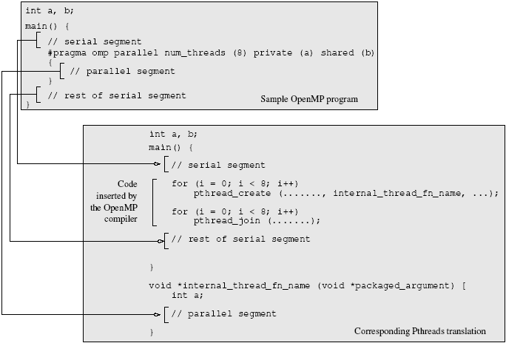
OpenMP Programming Model
A sample OpenMP program along with its Pthreads translation that might be performed by an OpenMP compiler.

Slide 6
OpenMP Programming Model
  #pragma omp parallel if (is_parallel== 1) num_threads(8) \
  private (a) shared (b) firstprivate(c) {
  /* structured block */
  }
If the value of the variable is_parallel equals one, eight threads are created.
Each of these threads gets private copies of variables a and c, and shares a single value of variable b.
The value of each copy of c is initialized to the value of c before the parallel directive.
The default state of a variable is specified by the clause default (shared) or default (none).

Slide 7
Reduction Clause in OpenMP
The reduction clause specifies how multiple local copies of a variable at different threads are combined into a single copy at the master when threads exit.
The usage of the reduction clause is reduction (operator: variable list).
The variables in the list are implicitly specified as being private to threads.
The operator can be one of +, *, -, &, |, ^, &&, and ||.
#pragma omp parallel reduction(+: sum) num_threads(8) {
/* compute local sums here */
}
/*sum here contains sum of all local instances of sums */

Slide 8
OpenMP Programming: Example
/* ******************************************************
An OpenMP version of a threaded program to compute PI.
****************************************************** */
#pragma omp parallel default(private) shared (npoints) \
  reduction(+: sum) num_threads(8)
{
  num_threads = omp_get_num_threads();
  sample_points_per_thread = npoints / num_threads;
  sum = 0;
  for (i = 0; i < sample_points_per_thread; i++) {
    rand_no_x =(double)(rand_r(&seed))/(double)((2<<14)-1);
    rand_no_y =(double)(rand_r(&seed))/(double)((2<<14)-1);
    if (((rand_no_x - 0.5) * (rand_no_x - 0.5) +
      (rand_no_y - 0.5) * (rand_no_y - 0.5)) < 0.25)
      sum ++;
  }
}
Notes:
Our first OpenMP example follows from Example 7.2, which presented a Pthreads program for the same problem. The parallel directive specifies that all variables except npoints, the total number of random points in two dimensions across all threads, are local. Furthermore, the directive specifies that there are eight threads, and the value of sum after all threads complete execution is the sum of local values at each thread. The function omp_get_num_threads is used to determine the total number of threads As in Example 7.2, a for loop generates the required number of random points (in two dimensions) and determines how many of them are within the prescribed circle of unit diameter.

Slide 9
Specifying Concurrent Tasks in OpenMP
The parallel directive can be used in conjunction with other directives to specify concurrency across iterations and tasks.
OpenMP provides two directives - for and sections - to specify concurrent iterations and tasks.
The for directive is used to split parallel iteration spaces across threads. The general form of a for directive is as follows:
  #pragma omp for [clause list]
    /* for loop */
The clauses that can be used in this context are: private, firstprivate, lastprivate, reduction, schedule, nowait, and ordered.

Slide 10
Specifying Concurrent Tasks in OpenMP: Example
#pragma omp parallel default(private) shared (npoints) \
  reduction(+: sum) num_threads(8)
{
  sum = 0;
  #pragma omp for
  for (i = 0; i < npoints; i++) {
    rand_no_x =(double)(rand_r(&seed))/(double)((2<<14)-1);
    rand_no_y =(double)(rand_r(&seed))/(double)((2<<14)-1);
    if (((rand_no_x - 0.5) * (rand_no_x - 0.5) +
      (rand_no_y - 0.5) * (rand_no_y - 0.5)) < 0.25)
      sum ++;
  }
}

Slide 11
Assigning Iterations to Threads
The schedule clause of the for directive deals with the assignment of iterations to threads.
The general form of the schedule directive is schedule(scheduling_class[, parameter]).
OpenMP supports four scheduling classes: static, dynamic, guided, and runtime.

Slide 12
Assigning Iterations to Threads: Example
/* static scheduling of matrix multiplication loops */
#pragma omp parallel default(private) shared (a, b, c, dim) \
  num_threads(4)
  #pragma omp for schedule(static)
  for (i = 0; i < dim; i++) {
    for (j = 0; j < dim; j++) {
      c(i,j) = 0;
      for (k = 0; k < dim; k++) {
        c(i,j) += a(i, k) * b(k, j);
      }
    }
  }

Slide 13
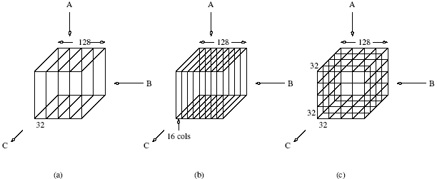
Assigning Iterations to Threads: Example
Three different schedules using the static scheduling class of OpenMP.
Notes:
Since there are four threads in all, if dim = 128, the size of each partition is 32
columns, since we have not specified the chunk size. Using schedule(static, 16)
results in the partitioning of the iteration space illustrated in Figure 7.5(b). Another
example of the split illustrated in Figure 7.5(c) results when each for loop in the
program in Example 7.13 is parallelized across threads with a schedule(static) and
nested parallelism is enabled (see Section 7.10.6).

